Slide 1
Task 5 VIX Data Engineer
Nama Peserta : Anton Diana

Slide 2
Business Objective:
Berapa banyak customer yang terlambat membayar tunggakan credit berdasarkan kategori pendapatannya
Dari besarnya pendapatan customer, paling tinggi jumlah customer yang status pernikahannya belum menikah, sudah menikah, sudah bercerai, atau tidak diketahui
Kemudian berapa total jumlah transaksi berdasarkan status pernikahan dan kategori pendapatannya

Slide 3
Eksplorasi Data :
Penggabungan data profil customer
Query :
WITH profil_cust AS (
SELECT * FROM vix_btpn.customer_data_history cdh
LEFT JOIN vix_btpn.category_db cd on cdh.card_categoryid = cd.id
LEFT JOIN vix_btpn.education_db ed on cdh.educationid = ed.id
LEFT JOIN vix_btpn.marital_db md on cdh.maritalid = md.id
LEFT JOIN vix_btpn.status_db sd on cdh.idstatus = sd.id
)
SELECT status, income_category, card_category, education_level, marital_status
FROM profil_cust
Result
status | income_category | card_category | education_level | marital_status
Existing Customer | $60K - $80K | Blue | High School | Married
Existing Customer | Less than $40K | Blue | Graduate | Single
Existing Customer | $80K - $120K | Blue | Graduate | Married
Existing Customer | Less than $40K | Blue | High School | Unknown
Existing Customer | $60K - $80K | Blue | Uneducated | Married
Existing Customer | $40K - $60K | Blue | Graduate | Married
Existing Customer | $120K + | Gold | Unknown | Married
Existing Customer | $60K - $80K | Silver | High School | Unknown
Existing Customer | $60K - $80K | Blue | Uneducated | Single
Existing Customer | $80K - $120K | Blue | Graduate | Single

Slide 4
Eksplorasi Data :
Customer berdasarkan status yang diattribusikan dan kategori pendapatannya
Query :
Result
WITH status_income AS (
SELECT * FROM vix_btpn.customer_data_history cdh
LEFT JOIN vix_btpn.status_db sd on cdh.idstatus = sd.id
)
SELECT status, income_category, COUNT(*) total FROM status_income
WHERE idstatus = 2
GROUP BY status, income_category
ORDER BY total DESC
status | income_category | total
Attrited Customer | Less than $40K | 612
Attrited Customer | $40K - $60K | 271
Attrited Customer | $80K - $120K | 242
Attrited Customer | $60K - $80K | 189
Attrited Customer | Unknown | 187
Attrited Customer | $120K + | 126

Slide 5
Eksplorasi Data :
Customer berdasarkan status yang diattribusikan dan status pernikahan
Query :
Result
WITH marital_status AS (
SELECT * FROM vix_btpn.customer_data_history cdh
LEFT JOIN vix_btpn.marital_db md on cdh.maritalid = md.id
LEFT JOIN vix_btpn.status_db sd on cdh.idstatus = sd.id
)
SELECT status, marital_status, COUNT(*) total FROM marital_status
WHERE idstatus = 2
GROUP BY status, marital_status
ORDER BY total DESC
status | marital_status | total
Attrited Customer | Married | 709
Attrited Customer | Single | 668
Attrited Customer | Unknown | 129
Attrited Customer | Divorced | 121

Slide 6
Eksplorasi Data :
Customer berdasarkan status pernikahan dan kategori pendapatan dimana statusnya diattribusikan
Query :
Result
WITH marital_income AS (
SELECT * FROM vix_btpn.customer_data_history cdh
LEFT JOIN vix_btpn.marital_db md on cdh.maritalid = md.id
LEFT JOIN vix_btpn.status_db sd on cdh.idstatus = sd.id
)
SELECT marital_status, income_category, COUNT(*) total FROM marital_income
WHERE idstatus = 2
GROUP BY marital_status, income_category
ORDER BY total DESC
marital_status | income_category | total
Married | Less than $40K | 263
Single | Less than $40K | 256
Married | $40K - $60K | 127
Single | $40K - $60K | 105
Married | $80K - $120K | 103
Single | $80K - $120K | 92
Married | $60K - $80K | 86
Single | Unknown | 78
Married | Unknown | 78
Single | $60K - $80K | 78
Single | $120K + | 59
Married | $120K + | 52

Slide 7
Eksplorasi Data :
Customer berdasarkan kategori pendapatan dan total transaksi dimana statusnya diattribusikan
Query :
Result
WITH status AS (
SELECT * FROM vix_btpn.customer_data_history cdh
LEFT JOIN vix_btpn.status_db sd on cdh.idstatus = sd.id
)
SELECT status, income_category, SUM(total_trans_amt) total_transaction FROM status
WHERE idstatus = 2
GROUP BY status, income_category
ORDER BY total_transaction DESC
status | income_category | total_transaction
Attrited Customer | Less than $40K | 1753529
Attrited Customer | $80K - $120K | 905229
Attrited Customer | $40K - $60K | 811029
Attrited Customer | $60K - $80K | 613566
Attrited Customer | Unknown | 524727
Attrited Customer | $120K + | 427527

Slide 8
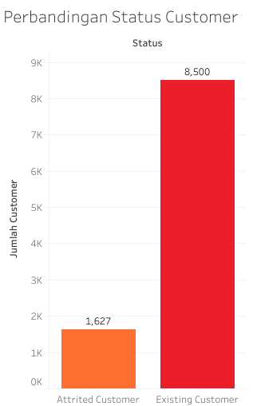
INSIGHT VISUALISATION :
Dari total keseluruhan cutomer yang ada,
sebesar 16% dengan status attrited customer, sedangkan customer status aktif sebesar 84%

Slide 9
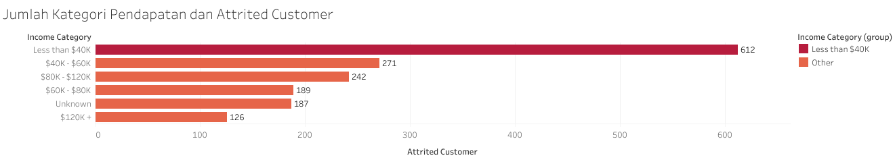
INSIGHT VISUALISATION :
Berdasarkan kategori pendapatan, attrited customer paling banyak dengan kategori pendapatan Less than $40K, atau sebesar 38% dari keseluruhan

Slide 10
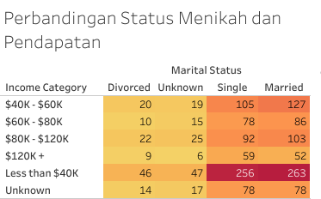
INSIGHT VISUALISATION :
Berdasarkan kategori pendapatan dengan status pernikahan, Attrited Customer paling tinggi dengan kategori pendapatan Less than $40K dengan status pernikahan Married dan kedua dengan status SIngle

Slide 11
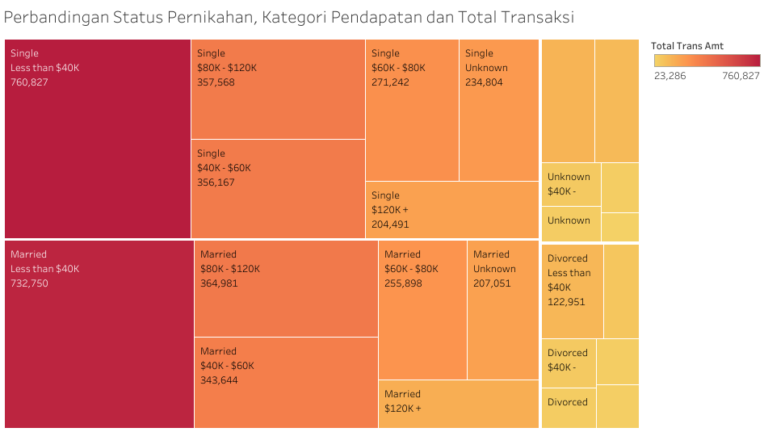
INSIGHT VISUALISATION :

Slide 12
Insight Presentation :
Berdasarkan visualisasi jumlah transaksi nya, Attrited Customer paling tinggi di dominasi oleh kategori pendapatan Less than $40K dan dengan status Single dan Married
Paling tinggi jumlah tranksaksi yaitu 760,827
Paling rendah jumlah tranksaksi dengan kategori pendapatan $120K dengan status unknown yaitu 23,286

Slide 13
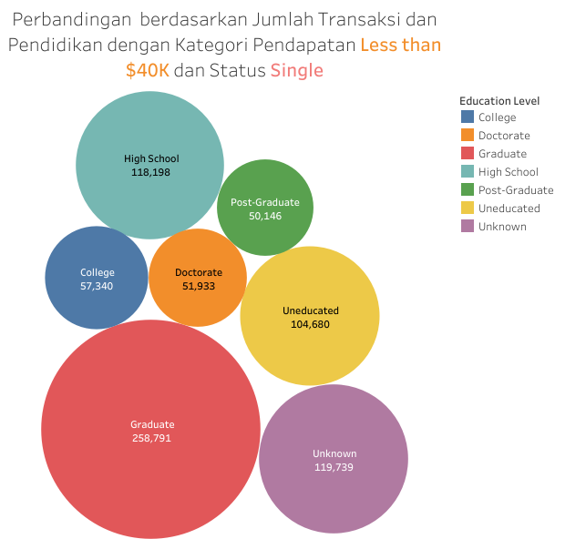
INSIGHT VISUALISATION :
Berdasarkan jumlah transaksi dan Pendidikan dengan kategori pendapatan Less than $40K dan Status Single, customer dengan jumlah transaksi paling tinggi, status pendidikannya Graduate, kedua Unkown, ketiga High School, ke empat Uneducated dan terakhir Post-Graduate

Slide 14
Kesimpulan dan Solusi:
Faktor kategori pendapatan rendah kurang dari $40,000, merupakan faktor yang paling sering membuat customer menunggak pembayaran kredit
Dengan kategori pendapatan yang rendah kurang dari $40,000, customer dengan status Married paling tinggi, dan urutan kedua dengan status Single
Berdasarkan jumlah transaksi paling banyak dilakukan oleh customer pendapatan rendah dan status Single dengan status Pendidikan Graduate
Dengan melakukan persyaratan maksimal untuk melakukan jumlah transaksi yaitu minimal 1 sampai 2 kali dari pendapatan customer

Slide 15
TERIMA KASIH

